Slide 1

Data Science Committee
Session 06 – Feature Selection
Prepared by: Ashraf Abdulkhaliq

Slide 2
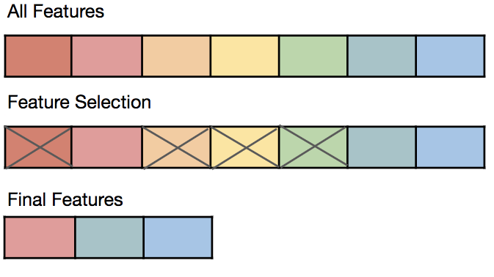
Introduction
Feature selection process is one of the main components of a feature engineering process.
Feature selection techniques are employed to reduce the number of input variables by eliminating redundant or irrelevant features.

Slide 3
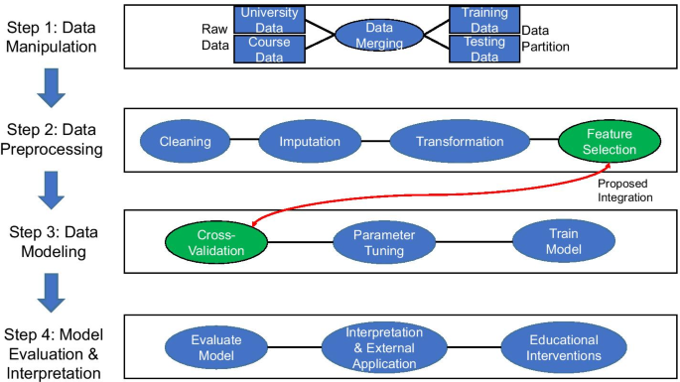
Introduction

Slide 4
Outline
Why Feature Selection?
Types of Features
Feature Selection Approaches
Filter Methods
Wrapper Methods
Embedded Methods
Feature Selection Appropriate Techniques
Feature Selection vs. Other Technologies & Methodologies

Slide 5
Outline
Why Feature Selection?
Types of Features
Feature Selection Approaches
Filter Methods
Wrapper Methods
Embedded Methods
Feature Selection Appropriate Techniques
Feature Selection vs. Other Technologies & Methodologies

Slide 6
Why Feature Selection
It helps in avoiding the curse of dimensionality.
It helps in the simplification of the model so that it can be easily interpreted.
It reduces the training time.
It reduces overfitting hence enhance the generalization.

Slide 7
Outline
Why Feature Selection?
Types of Features
Feature Selection Approaches
Filter Methods
Wrapper Methods
Embedded Methods
Feature Selection Appropriate Techniques
Feature Selection vs. Other Technologies & Methodologies

Slide 8
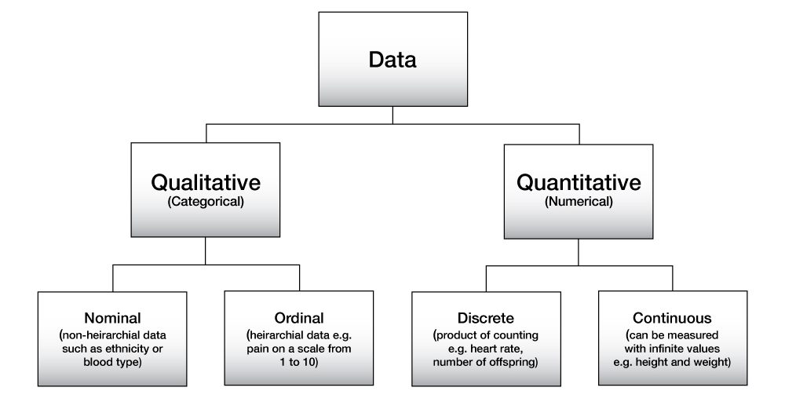
Types of Features (DATA)

Slide 9
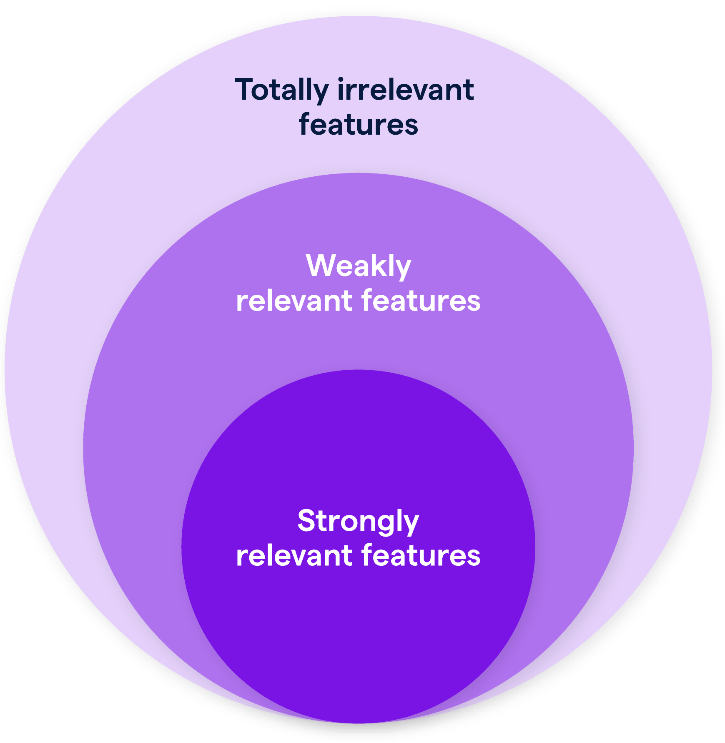
Types of Features (DATA)
Totally Irrelevant Features: These features lack any connection or impact on the target variable, offering no valuable information to the model.
Weakly Relevant Features: While they have some association with the target variable, it’s provided only minor contributions to the model's performance and contain limited information.
Strongly Relevant Features: These features are closely linked to the target variable, significantly enhancing the model's performance by containing crucial information necessary for accurate predictions.

Slide 10
Outline
Why Feature Selection?
Types of Features
Feature Selection Approaches
Filter Methods
Wrapper Methods
Embedded Methods
Feature Selection Appropriate Techniques
Feature Selection vs. Other Technologies & Methodologies

Slide 11
Feature Selection Approaches
Supervised Features Selection
Filter Methods
Missing Value Ratio
Correlation
Chi-Square
Wrapper Methods
Forward Selection
Backward Elimination
Exhaustive Feature Selection
Recursive Feature Elimination
Embedded Methods
L1/L2 Regularization
Tree-Based Algorithms Importance

Slide 12
Outline
Why Feature Selection?
Types of Features
Feature Selection Approaches
Filter Methods
Wrapper Methods
Embedded Methods
Feature Selection Appropriate Techniques
Feature Selection vs. Other Technologies & Methodologies

Slide 13
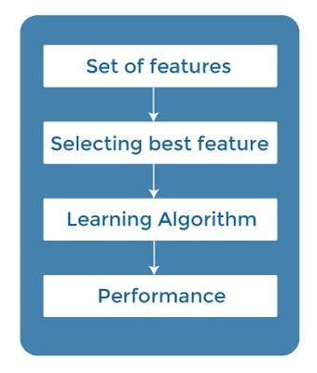
Filter Methods
In this method, features are dropped based on their relation to the target feature, or how they correlating to the target feature.
Advantage of using filter methods is that it needs low computational time and does not overfit the data.

Slide 14
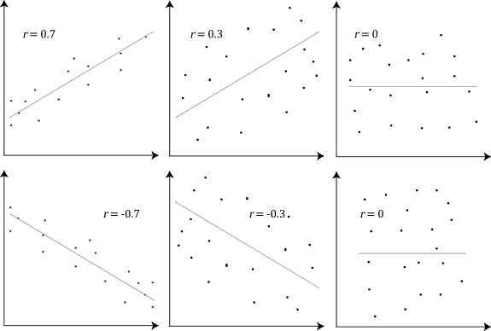
Filter Methods (Examples)
Correlation: It is used to quantify linear dependence between two continuous variables, X and Y. Its value ranges from -1 to 1.
Usage?
Input variable is numerical
output variable is numerical

Slide 15
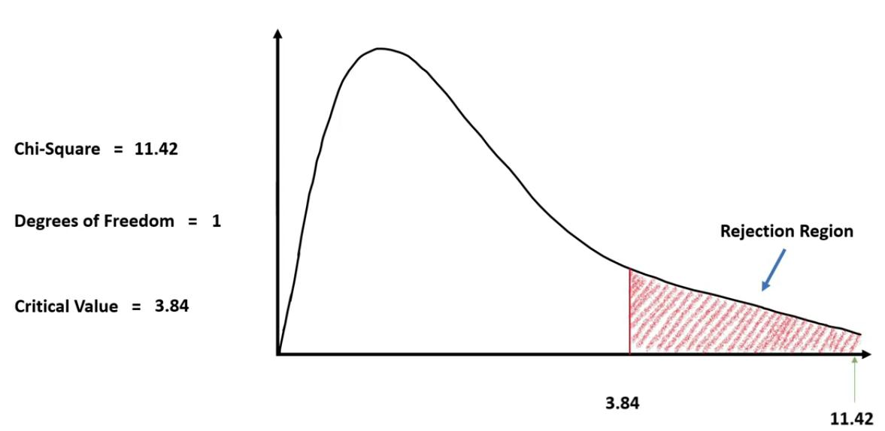
Filter Methods (Examples)
Chi-Square: Chi-square test is a technique to determine the relationship between the categorical variables. Chi-Square value is calculated between each feature and the target variable.
if critical value < chi-square, then H0: no relationship
if critical value > chi-square, then H1: there is a relationship
Usage?
Input variable is categorical
output variable is categorical
Tutorial: https://www.youtube.com/watch?v=L6zWgsilOAs

Slide 16
Filter Methods (Examples)
Missing Value Ratio: The value of the missing value ratio can be used for evaluating the feature set against the threshold value.
Usage?
Input variable is any (numerical/categorical)
output variable is any (numerical/categorical)
$$Missing Value Ratio = \frac{Number of Missing Values}{Total Number of Obdervations}×100$$

Slide 17
Outline
Why Feature Selection?
Types of Features
Feature Selection Approaches
Filter Methods
Wrapper Methods
Embedded Methods
Feature Selection Appropriate Techniques
Feature Selection vs. Other Technologies & Methodologies

Slide 18
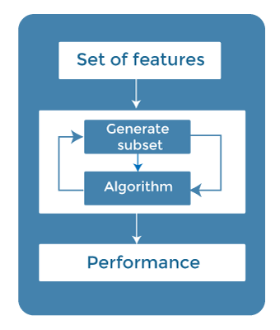
Wrapper Methods
We split our data into subsets and train a model using this. Based on the output of the model, then we add and substract features and train the model again

Slide 19
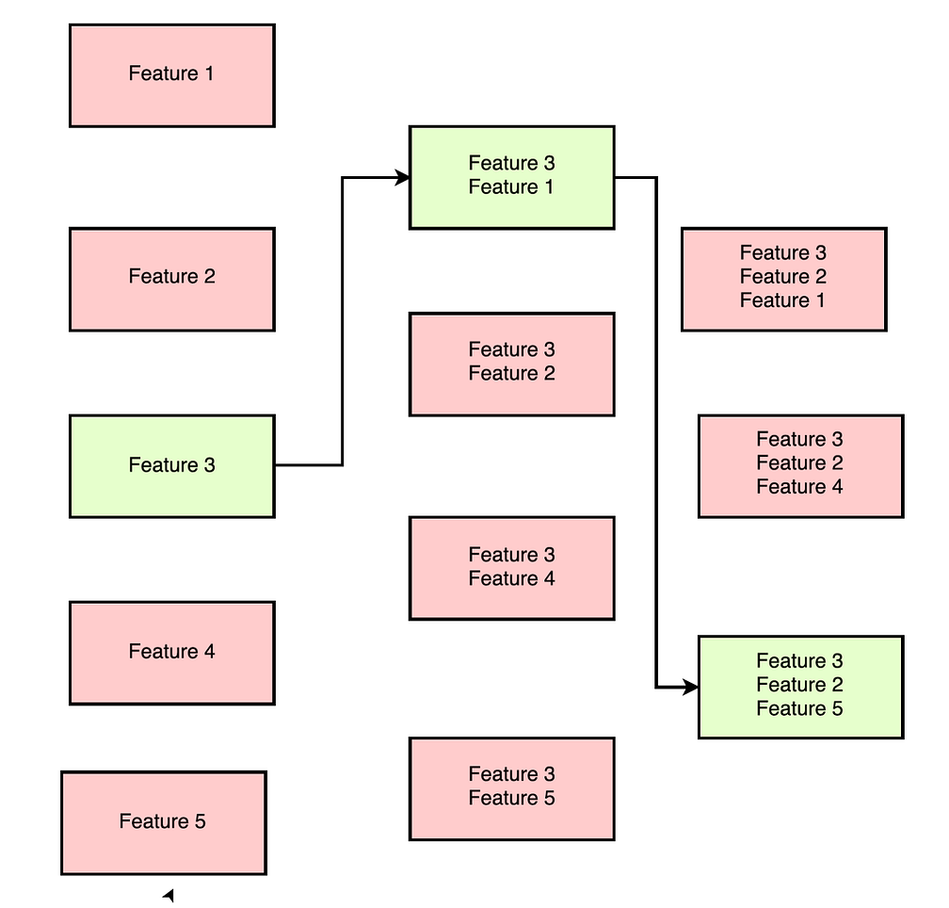
Wrapper Methods (Examples)
Forward selection:
An iterative process, which begins with an empty set of features.
After each iteration, it keeps adding on a feature and evaluates the performance to check whether it is improving the performance or not.
The process continues until the addition of a new variable/feature does not improve the performance of the model.

Slide 20
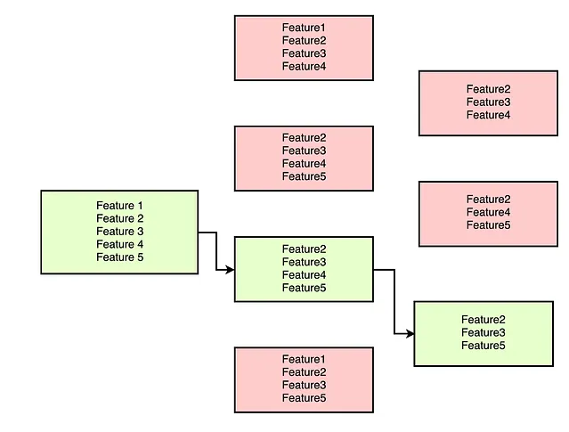
Wrapper Methods (Examples)
Backward elimination
Also an iterative approach, but it is the opposite of forward selection.
This technique begins the process by considering all the features and removes the least significant feature.
This elimination process continues until removing the features does not improve the performance of the model.

Slide 21
Wrapper Methods (Examples)
Exhaustive Feature Selection: One of the best feature selection methods, which evaluates each feature set as brute-force. It means this method tries & make each possible combination of features and return the best performing feature set.
Recursive Feature Elimination: A recursive greedy optimization approach, where features are selected by recursively taking a smaller and smaller subset of features.

Slide 22
Outline
Why Feature Selection?
Types of Features
Feature Selection Approaches
Filter Methods
Wrapper Methods
Embedded Methods
Feature Selection Appropriate Techniques
Feature Selection vs. Other Technologies & Methodologies

Slide 23
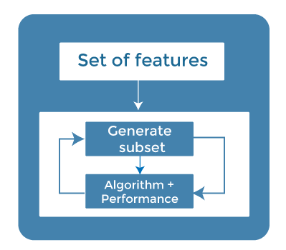
Embedded Methods
This method combines the qualities of both filter and wrapper methods to create the best subset.
Model will train and check the accuracy of different subsets and select the best among them.

Slide 24
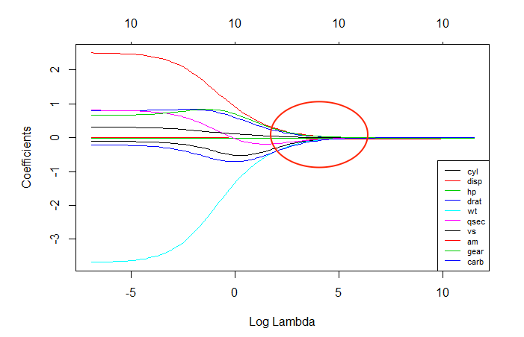
Embedded Methods (Examples)
Usage?
Input variable is numerical
output variable is numerical
L1/L2 Regularization
adds a penalty term to different parameters of the machine learning model for avoiding overfitting.
This penalty term is added to the coefficients; hence it shrinks some coefficients to zero.
Those features with zero coefficients can be removed from the dataset.

Slide 25
Embedded Methods (Examples)
Tree-Based Algorithms Importance
Different tree-based methods of feature selection help us with feature importance to provide a way of selecting features.
Feature importance specifies which feature has more importance in model building or has a great impact on the target variable.
Random Forest is such a tree-based method, which is a type of bagging algorithm that aggregates a different number of decision trees.
It automatically ranks the nodes by their performance or decrease in the impurity (Gini impurity) over all the trees.
Nodes are arranged as per the impurity values, and thus it allows to pruning of trees below a specific node. The remaining nodes create a subset of the most important features.

Slide 26
Outline
Why Feature Selection?
Types of Features
Feature Selection Approaches
Filter Methods
Wrapper Methods
Embedded Methods
Feature Selection Appropriate Techniques
Feature Selection vs. Other Technologies & Methodologies

Slide 27
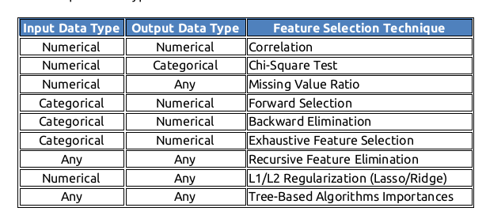
Feature Selection Appropriate Techniques

Slide 28
Outline
Why Feature Selection?
Types of Features
Feature Selection Approaches
Filter Methods
Wrapper Methods
Embedded Methods
Feature Selection Appropriate Techniques
Feature Selection vs. Other Technologies & Methodologies

Slide 29
Feature Selection vs. Extraction
The key difference between feature selection and extraction is that feature selection keeps a subset of the original features while feature extraction algorithms transform the data onto a new feature space. Some supervised algorithms already have built-in feature selection, such as Regularized Regression and Random Forests.
In summary:
Extraction: Getting useful features from existing data.
Selection: Choosing a subset of the original pool of features.

Slide 30
Feature Selection vs. Dimensionality Reduction
A feature selection is simply selecting or excluding given features without modifying them in any way.
Dimensionality reduction reduces the dimensions of features. By contrast, the set of features made by feature selection must be a subset of the original set of features. The set made by dimensionality reduction does not have to be (for example, PCA reduces dimensionality by making new synthetic features by linearly combining the original features, then discarding the less important ones). This way, feature selection is a special case of dimensionality reduction.

Slide 31
References
https://oercollective.caul.edu.au/foundations-of-biomedical-science/chapter/9-1-types-of-data/
https://www.featureform.com/post/feature-engineering-guide
https://h2o.ai/wiki/feature-selection/
https://www.javatpoint.com/feature-selection-techniques-in-machine-learning
https://medium.com/@sagar.rawale3/feature-selection-methods-in-machine-learning-eaeef12019cc

Slide 32
Thanks
Please keep updated:
https://github.com/kershrita/Data-Science-Roadmap

